Slide 1
DITIGAL PORTFOLIO
STUDENT NAME: A.ABINAYA SELVI
REGESTER NO AND NMID:222403797/asunm29222403797
DEPARTMENT:BSC Computer Science
COLLAGE NAME: VIDHYA SAGAR WOMEN’S COLLAGE

Slide 2
MY PORTFOLIO
BY:
A.ABINAYA SELVI

Slide 3
AGENDA
1.Problem Statement
2.Project Overview
3.End User
4.Tools and Technologies
5.Portfolio design and Layout
6.Features and Functionality
7.Result and Screenshots
8.Conclusion
9.Github Link

Slide 4
PROBLEM STATEMENT
Many students and professionals struggle to effectively showcase their skills, achievements, and projects using only a traditional resume
A resume often lacks interactivity, creativity, and accessibility for a wider audience.
Recruiters and evaluators require a more engaging, well-organized, and digital-friendly platform to assess an individual’s potential.
Without a digital portfolio, opportunities for visibility, networking, and personal branding are limited.
Therefore, there is a need for a personalized digital portfolio that highlights one’s identity, academic background, technical skills, certifications, and achievements in an interactive and accessible format.

Slide 5
PROJECT OVERVIEW
The project “My Portfolio” is a personal digital portfolio designed to present an individual’s academic, technical, and personal achievements in a structured and interactive manner.
It serves as an online resume that goes beyond static documents, offering creativity and easy accessibility.
The portfolio includes sections such as About Me, Skills, Achievements, Certificates, Projects, and Contact Information.
The main goal is to showcase talents, build credibility, and create opportunities for education, career, and networking.

Slide 6
WHO ARE THE END USERS ?
Students – to showcase their academic records, skills, and projects for internships or higher studies.
Job Seekers – to present their portfolio to recruiters and hiring managers in a professional way.
Educational Institutions – to evaluate students’ achievements, certifications, and extracurricular activities.
Employers / Recruiters – to assess candidates’ technical skills, creativity, and personal branding.
General Audience / Peers – to connect, collaborate, and gain inspiration from the portfolio.

Slide 7
TOOLS AND TECHNIQUES
Frontend Technologies:
HTML – for structure and layout of web pages
CSS :
for styling and designing of web pages
JavaScript :
for interactivity and animations of web pages
Code using (VS code):
each section is given a unique ID to allow easy linking and smooth scrolling with visual studio code

Slide 8
PORTFOLIO DESIGN AND LAYOUT
Homepage – Introduction with name, course, and a short tagline.
About Me – Personal details, education background, and career goals.
Skills Section – List of technical of (Python programming , UI/UX, HTML, CSS, Java script)with icons or progress indicators.
Certificates & Contact – Display of My Certifications./abinayapandiselvi676@gmail.com
Education – Details of academic years & percentage
Contact Section – Email, phone number, and social media links.
Simple & Responsive Design – Accessible across desktop and mobile devices.

Slide 9
FEATURES AND FUNCTIONALITY
User-Friendly Interface – Simple navigation for easy access to all sections.
Responsive Design – Works smoothly on desktop, tablet, and mobile devices.
Downloadable Certificates - – Option to download my certificates in PDF format.
Organized Sections – Clearly separated areas for About me, Education, Skills, Certificates ,Contact details
Downloadable Resume – Option to download resume in PDF format.
Contact Form – Allows visitors to see my contact details

Slide 10
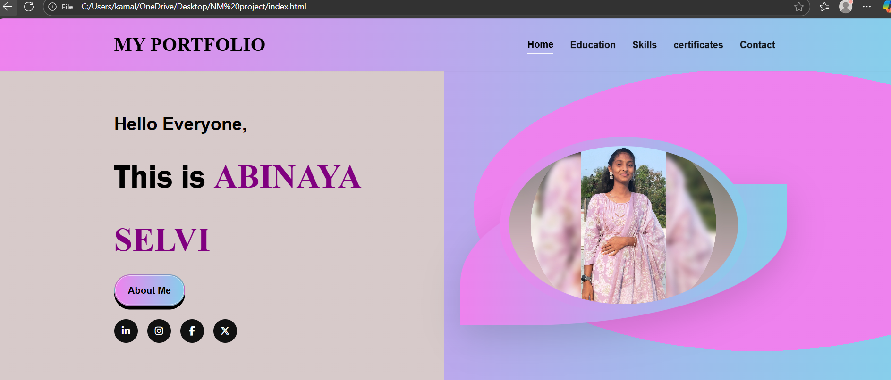
RESULTS AND SCREENSHOTS

Slide 11
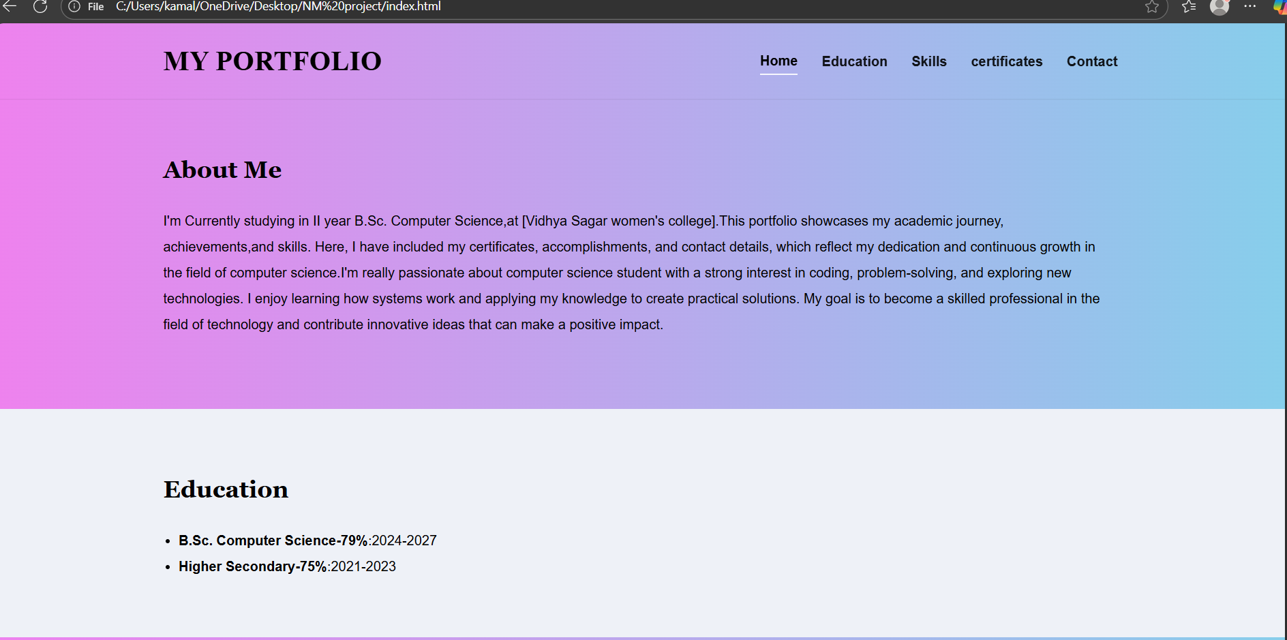
RESULTS AND SCREENSHOTS

Slide 12
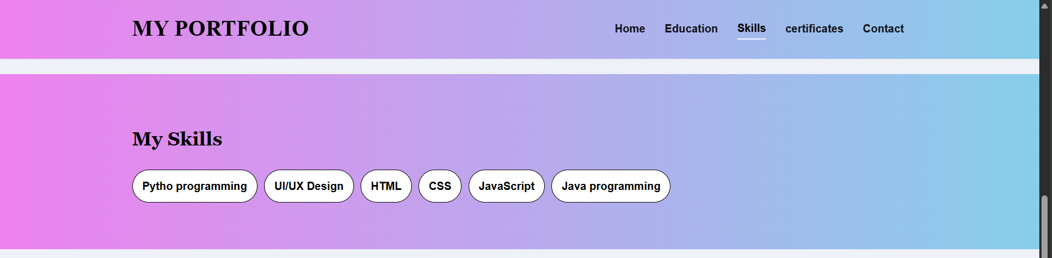
RESULTS AND SCREENSHOTS

Slide 13
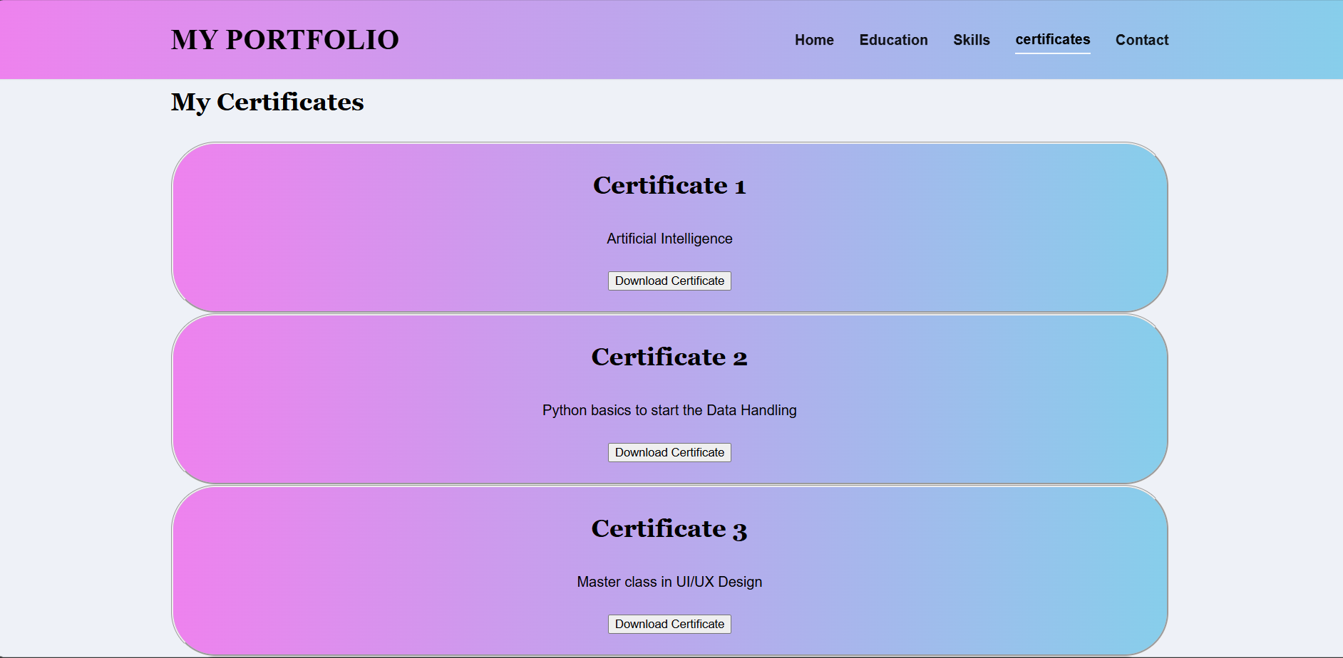
RESULTS AND SCREENSHOTS

Slide 14
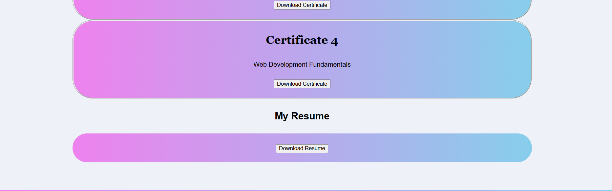
RESULTS AND SCREENSHOTS

Slide 15
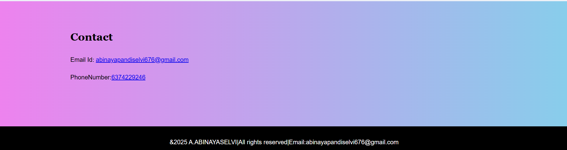
RESULTS AND SCREENSHOTS

Slide 16
CONCLUSION
The project “My Portfolio” provided a platform to showcase personal, academic, and professional achievements in an effective manner.
It enhanced skills in HTML, CSS, JavaScript, and design tools.
The portfolio demonstrates creativity, technical knowledge, and personal branding.
It can be used for higher studies, internships, and job opportunities.
Future improvements may include adding a blog and advanced design features.

